Slide 1


Architecture Premier League
My REC – Think Food Think Us
Team Name – unnamed_v1
Ratul Pal
Prateek Ralhan
Smita Nayak
Sumit Kumar

Slide 2
Table of Contents
Problem Definition and User Journey
Solution Architecture and IT Principles Coverage
Technology Stack
Entity Relationship Diagram
User Interface
Questions and Comments

Slide 3

Problem Statement & User Journey
MyRec is a smart kitchen assistant helping users cook more variety in the kitchen by providing a lot of recipes to cook.
The app broadly has 3 sections:
View & Organize Recipes
Explore Recipes
User Recipes (web, doc, scan, handwritten)
Organize recipes (liked, saved, create cookbook)
Create & Customize Meal plans
Shopping List & Ingredients Shopping
Our Mission is to make cooking east and enjoyable by eliminating everyday kitchens hassles

Slide 4
Assumptions
Meal planner can be availed for MyRec recipes only
1M+ user base for the app
App functionality is worldwide. However, ingredient shopping is currently only available in India. We would consider options based on the requirement.
BigZee is a trusted grocery chain in India. It has its presence in most of the major cities. However, ingredients’ delivery option is dependent on the zip code of the customer.

Slide 5
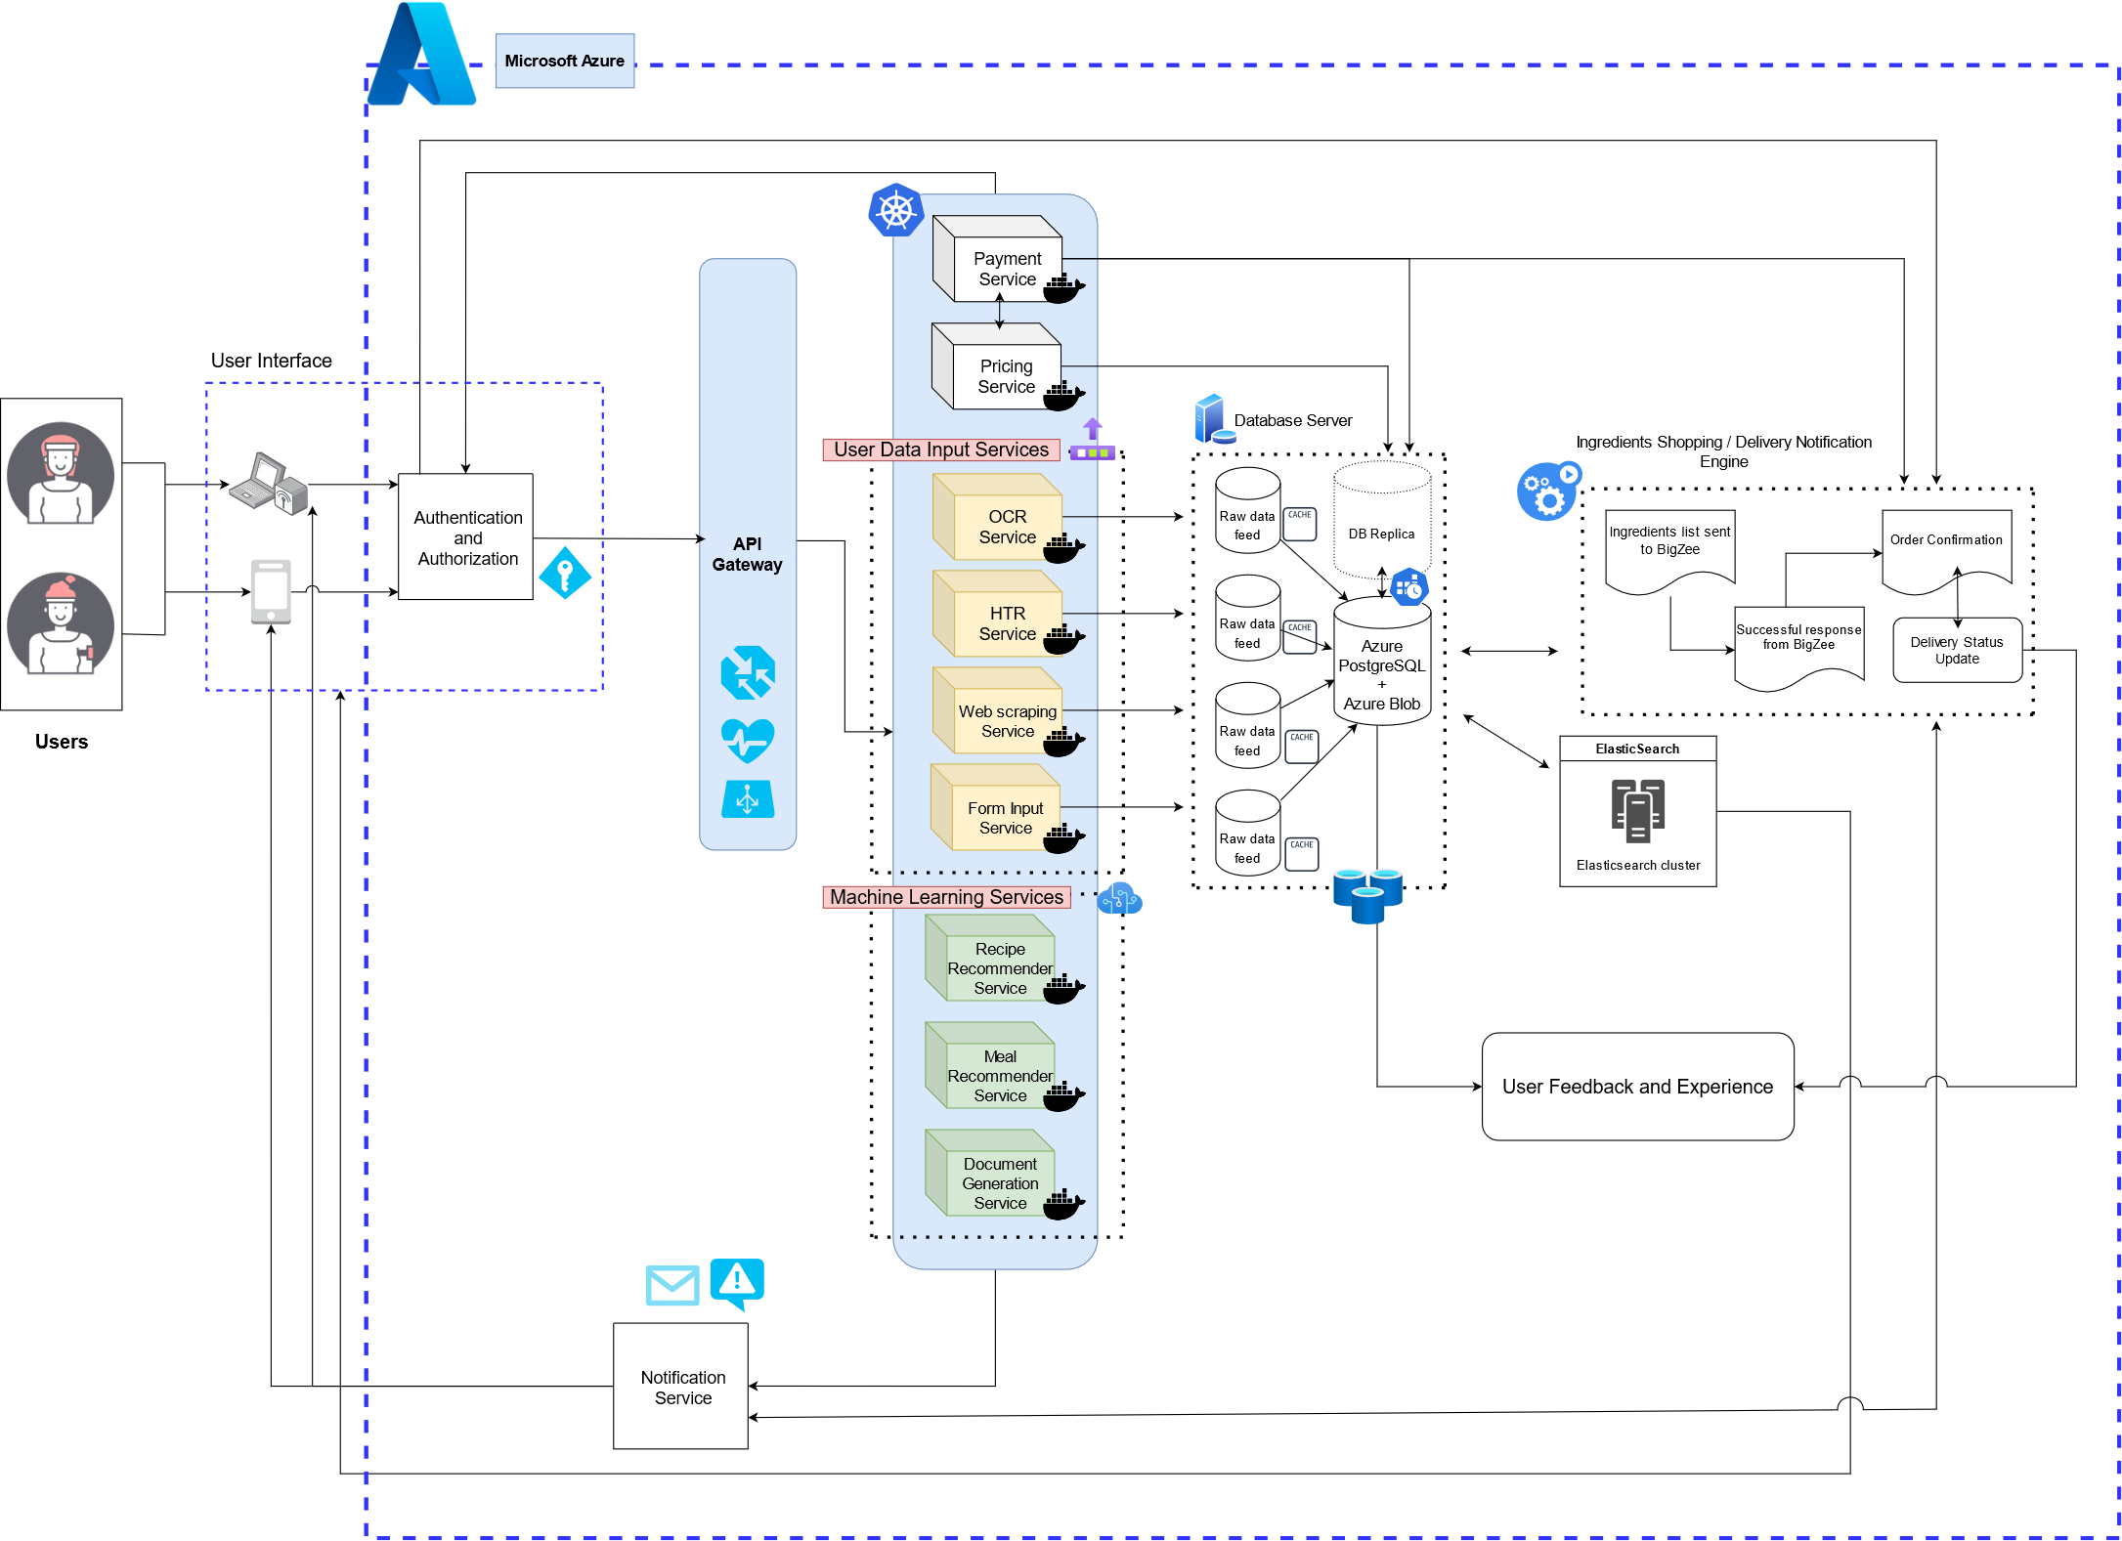
Solution Architecture
Designed using: https://app.diagrams.net/

Slide 6

IT Principles Coverage
Scalability
High Availability
Enterprise-Wide
Security
Platform Independent
Customer Focus
Ease of Use
Data Protection
Productivity
Bleeding Edge
Data Confidentiality

Slide 7
















Technology Stack
Components | Services/Packages
Operating System | Linux based Dockerized Container Instances in Azure Container Registry maintained and deployed using Azure Kubernetes Service.
UI | Flutter ( cross platform application development )
Programming Languages | JavaScript
Backend Framework | NodeJS, ExpressJS
IDE | Microsoft Visual Code
DevOps , CI/CD pipelines | Jenkins
APIs and Services | Payment - Razor pay - COD ( only for ingredients shopping ) OCR - Individual Service - tesseract.js HTR - Azure Cloud Vision APIs. Web Scraping / Recipe Import - Puppeteer ( NodeJS ) Document Generation Service (PDF.js) ML based services - Apache spark - Java/Python
Authentication | Azure based built in Authentication Service ( Supporting SSO, SAML and OpenID)
Monitoring | Azure Monitor and Azure Application Insights
Security & Threat Protection | Cloudflare (DDoS Protection), Azure Security Center, Azure Sentinel ( for advanced threat detection, alert-based system etc. )
Load Balancer | Azure Api gateway with App Management Services, comprising in built Azure Load Balancer and Inbuilt web application firewall
Network Protocols | HTTPs ( REST APIs )
Analytics | Chart.js ( User self Tracking), Business Analytics (Power BI/Tableau), Website Analytics (Google Analytics), Azure Sentinel ( for advanced behavioral analytics insights, threat detection, alert-based system etc. )

Slide 8
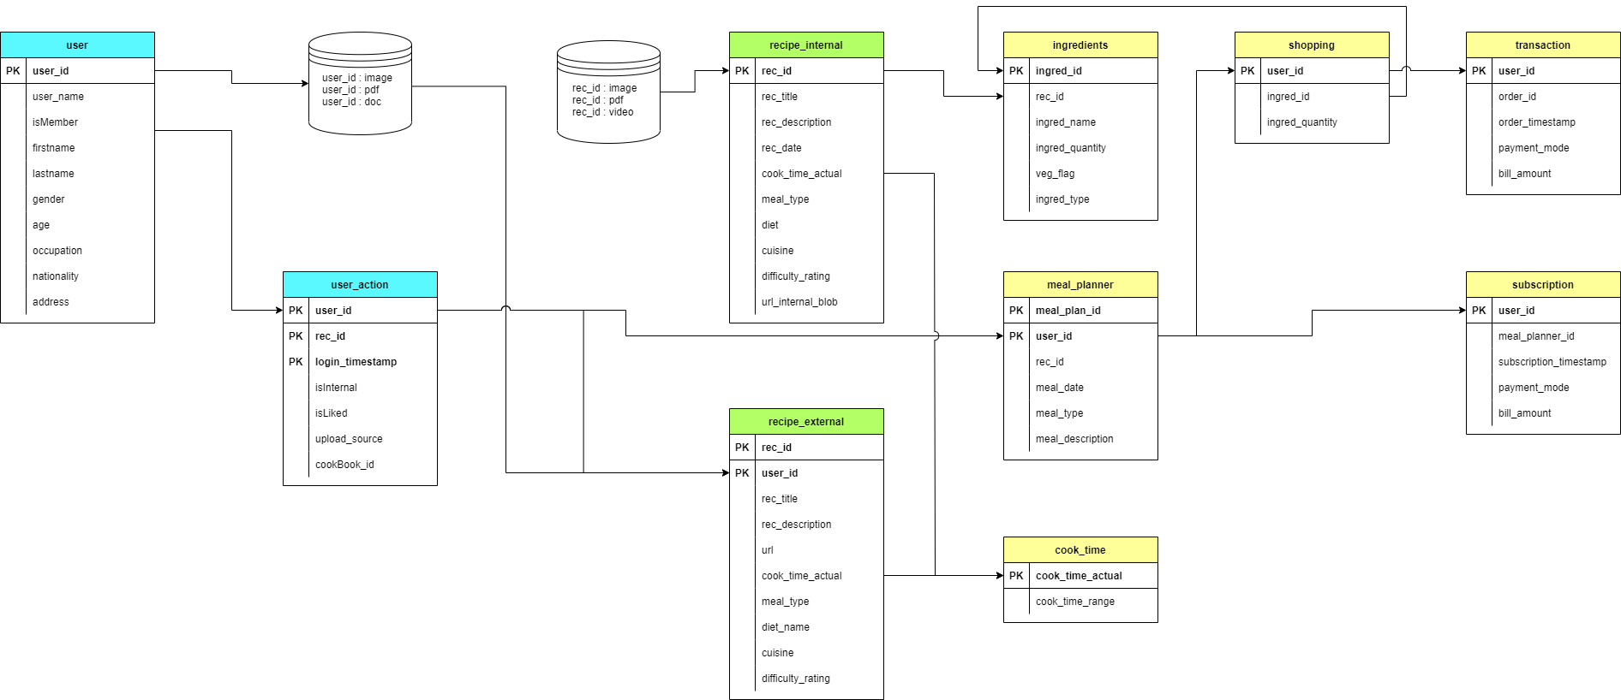
Entity Relationship Diagram
Designed using: https://app.diagrams.net/

Slide 9
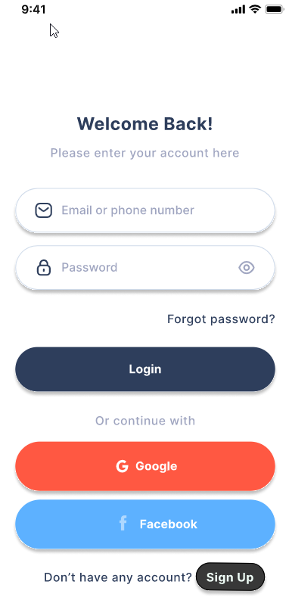
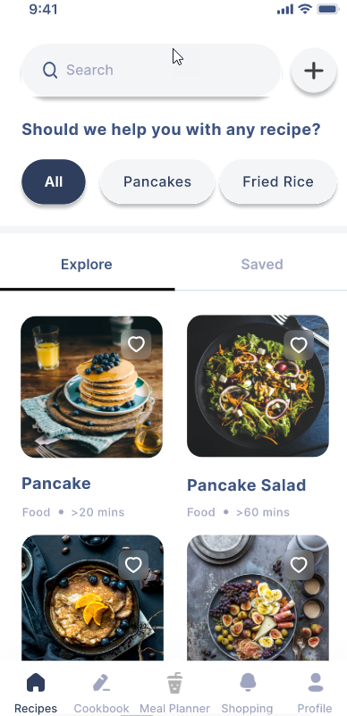
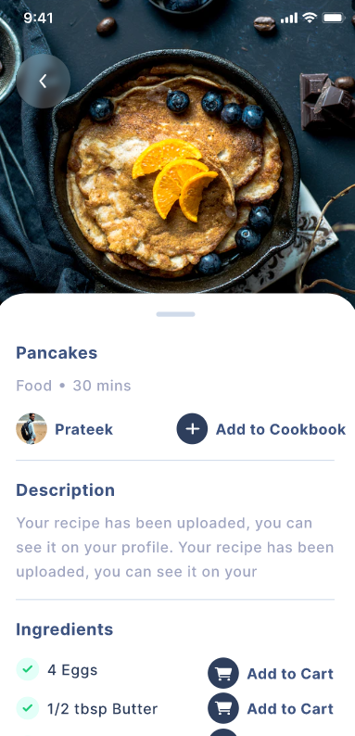
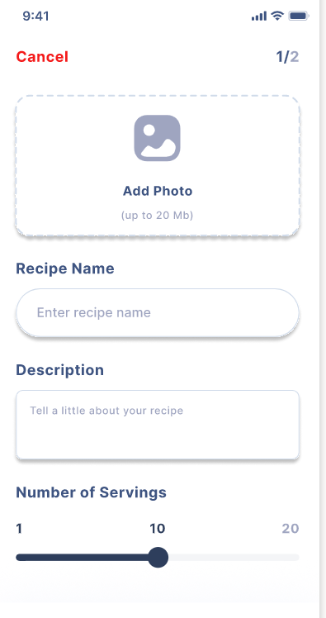

User Interface
UI Designed using: Figma , Icons Build pack: fontawesome , Images : Unsplash

Slide 10

When did you become an expert in IT solutions?
Last Week

Slide 11







Thank you!
Contact us
Follow us
Sumit Kumar
Ratul Pal
Smita Nayak
Prateek Ralhan
Analytics Solution Specialist
Finance Analytics Specialist
Finance Analytics Specialist
Digital Solutions Engineer
11

Slide 12

Any questions?
March 2022

Slide 14
Legal notice
©2022 Swiss Re. All rights reserved. You may use this presentation for private or internal purposes but note that any copyright or other proprietary notices must not be removed. You are not permitted to create any modifications or derivative works of this presentation, or to use it for commercial or other public purposes, without the prior written permission of Swiss Re.
The information and opinions contained in the presentation are provided as at the date of the presentation and may change. Although the information used was taken from reliable sources, Swiss Re does not accept any responsibility for its accuracy or comprehensiveness or its updating. All liability for the accuracy and completeness of the information or for any damage or loss resulting from its use is expressly excluded.

